Slide 1





SHADAN WOMEN'S COLLEGE OF ENGINEERING AND TECHNOLOGY
[ An Autonomous Institution Affiliated to JNTUH ]
OPTICAL FIBRE COMMUNICATION
Name : Amath ur Rasheed Umama Azmath
Ht no. : 24L51A0508
Class : B.tech 3rd Year 1st semester
Section : CSE - A
Subject : Computer Networks

Slide 2


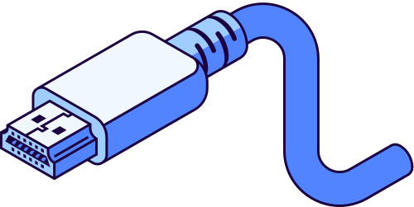
INTRODUCTION
  Fiber optic technology operates on the principle of total internal reflection to transmit data signals at nearly the speed of light.
  ​It serves as the primary backbone for modern telecommunications, offering significantly higher bandwidth and lower signal loss over long distances compared to traditional copper wiring.

Slide 3
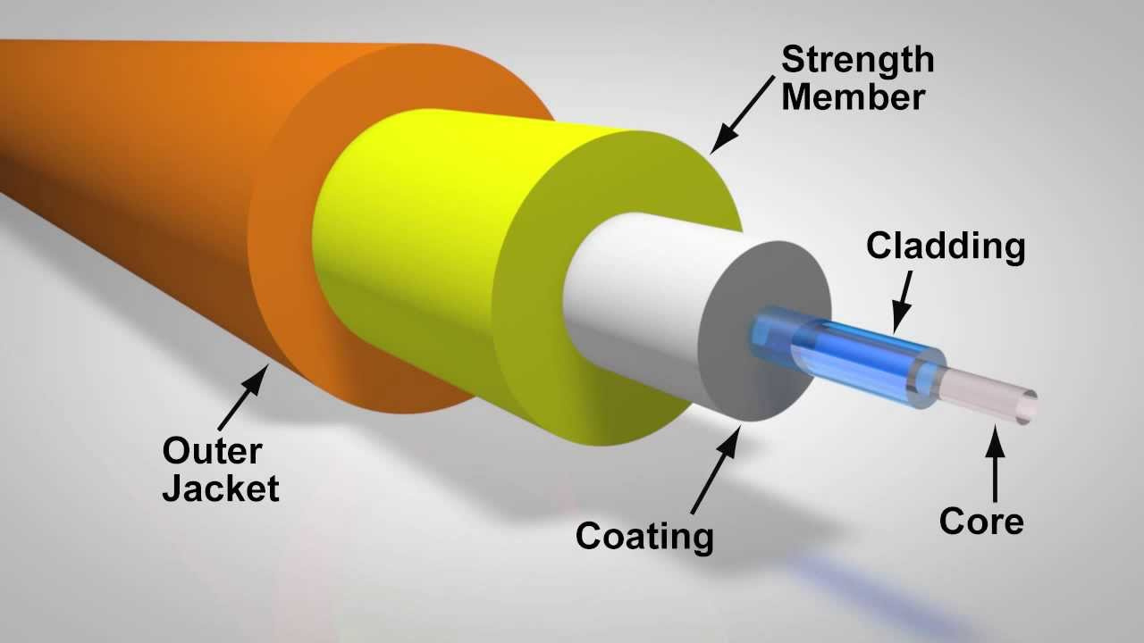
MAIN COMPONENTS
▪︎Core: The innermost thin glass or plastic cylinder where light pulses travel.
▪︎​Cladding: The outer optical material surrounding the core that has a lower refractive index, reflecting light back into the core.
▪︎​Buffer Coating: A protective layer of plastic surrounding the cladding to shield the glass from moisture and physical damage.
▪︎Outer Jacket: The tough exterior sheath that houses one or multiple fibers to protect against environmental hazards during installation.
Create a Home Office

Slide 4
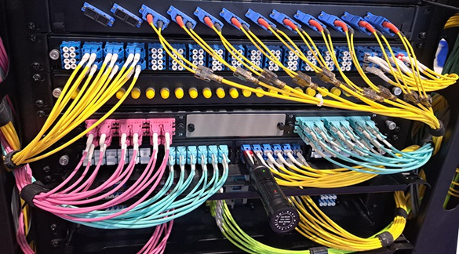
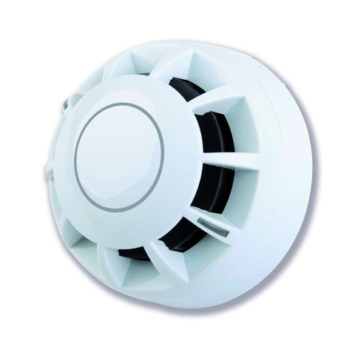
OPTIC FIBRE CABLE TECHNOLOGY
▪︎Light Sources: Light-Emitting Diodes (LEDs) or Laser Diodes generate the light pulses passed through the fiber.
▪︎​Optical Detectors: Photodiodes and Avalanche Photodiodes (APDs) detect incoming light signals at the receiving end and convert them back into electrical data.
​▪︎Fiber Connectors: Connectors such as LC, SC, ST, and FC secure physical connections between optical cables and networking hardware.

Slide 5
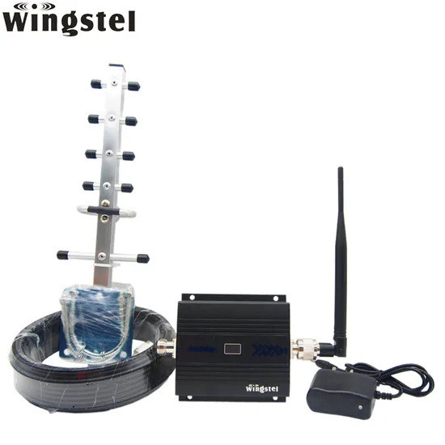
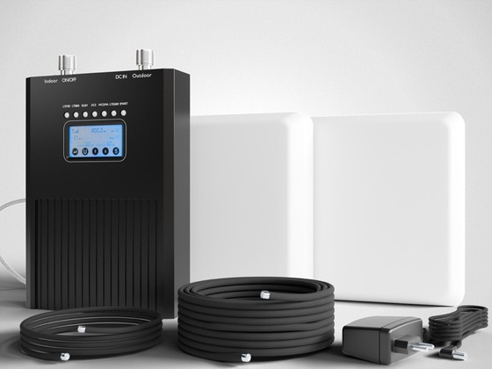
▪︎Signal Repeaters and Amplifiers: Devices like Erbium-Doped Fiber Amplifiers (EDFA) boost optical signals across long transmission spans without converting them to electrical form.
​▪︎Multiplexing Systems: Wavelength Division Multiplexing (WDM) combines multiple light signals of varying wavelengths onto a single optical fiber strand to maximize data capacity.
​▪︎Data Link Protocols: High-speed network standards, such as SONET/SDH, FDDI, and Fiber Channel, govern framed data transfer over optical networks.

Slide 6
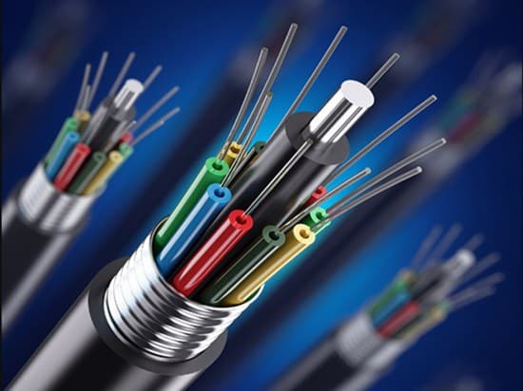
APPLICATIONS
▪︎Transatlantic and undersea telecommunication cables connecting continents and global data networks.
​▪︎Fiber-to-the-Home (FTTH) broadband installations supplying high-speed gigabit internet to residences.
​▪︎Enterprise Data Centers for high-speed server interconnects and Storage Area Networks (SANs).
​▪︎Medical equipment such as endoscopes for precise internal imaging during non-invasive surgeries.

Slide 7
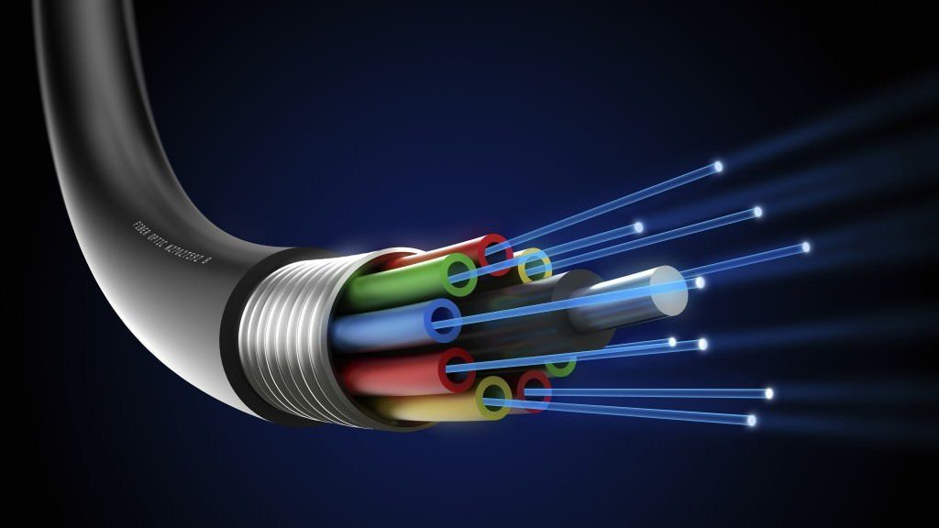

CONCLUTION
​Fiber optics form the critical infrastructure underpinning modern internet backbones and high-speed data delivery.
​Future network expansions will continue relying on optical fibers to handle growing demands for 5G, cloud computing, and real-time data streaming.

Slide 8
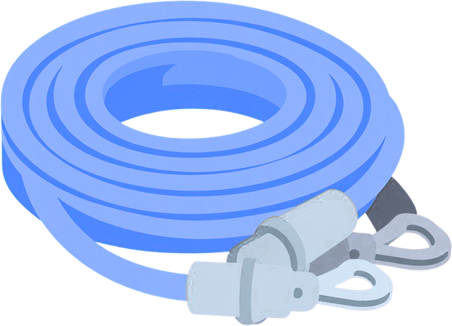
THANK YOU

